Slide 2
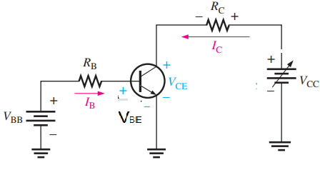
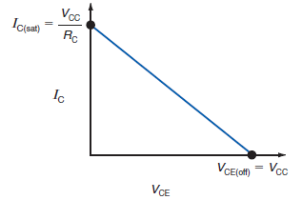
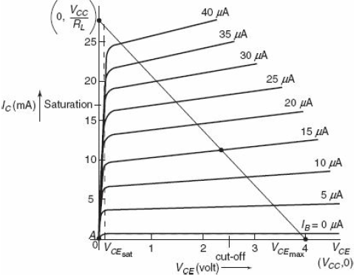


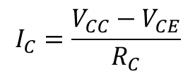
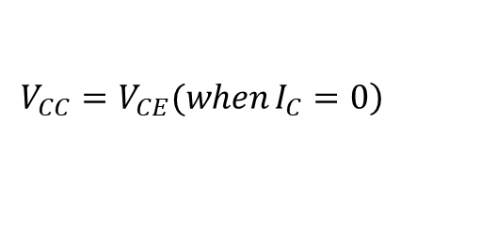

DC Load line
The dc load line is a graph that allows us to determine all possible combinations of I_{C} and V_{CE} for a given amplifier.
$$V_{CC}−I_{C}R_{C}−V_{CE}=0$$
$$I_{C}R_{C}=V_{CC}−V_{CE}$$
At cutoff region Ic=0
$$\left.V_{CC}=V_{CE}(when I_{C}=0\right)$$
At saturation region V_{CE}=0
$$I_{C}=\frac{V_{CC}−V_{CE}}{R_{C}}$$
$$I_{C}=\frac{V_{CC}}{R_{C}}(when V_{CE}=0)$$
The endpoints of the dc load line are labeled I_{C}(sat) and V_{CE}(off) . The collector current and the output voltage can not exceeds this limit

Slide 3
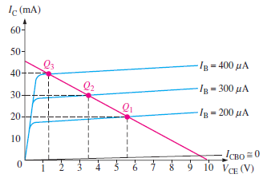
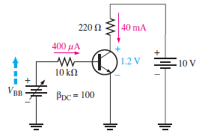
Operating point or Quiescent(Q)-point
It is the intersection point between the load line and output characteristic curve under a specific value of base current.
The operating point is also called DC point. The Quiescent point meaning it is not having any AC signal only DC biasing signal is there.
It is possible to operate the amplifier at any point along the load line. The best operating point is usually in the center of the load line.

Slide 4
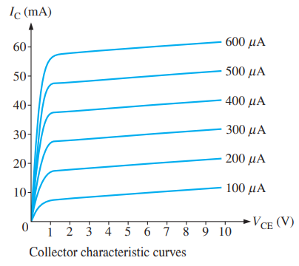
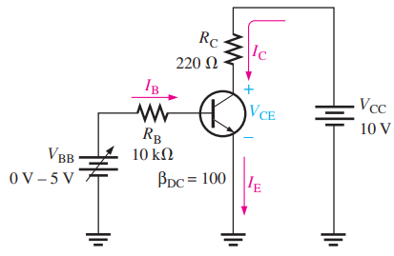
Biasing
To operate the transistor, it should be operated at a particular operating point. The process of selecting the operating point is called biasing
It is achieved by suitably selecting the DC sources and the resistors to operate the transistor in active region.
To operate the transistor properly as an amplifier, the two pn junctions must be correctly biased with external dc voltages.
In general the DC signal is used for biasing and the input AC signal is to be amplified

Slide 5
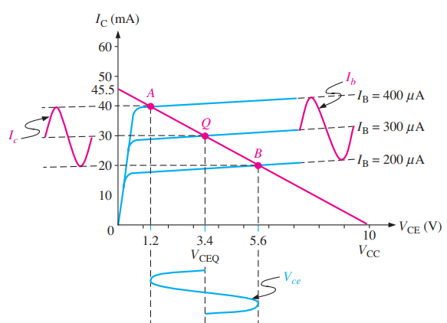
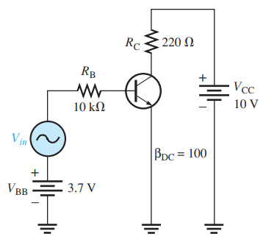
Bias circuits set the dc level at a point that allows the ac signal to vary in both the positive and negative directions without driving the transistor into saturation or cutoff.

Slide 6
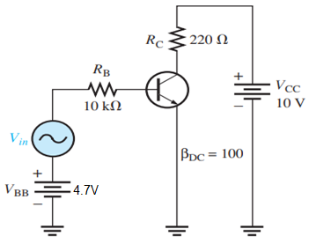
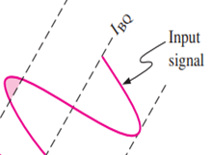
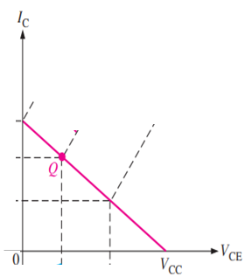
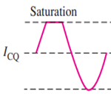
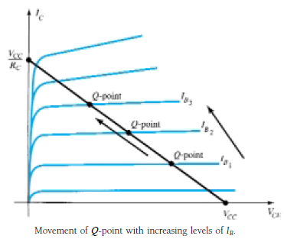
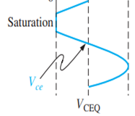
If the level of I_{B} is changed by varying the value of R_{B} the Q-point moves up or down

Slide 7
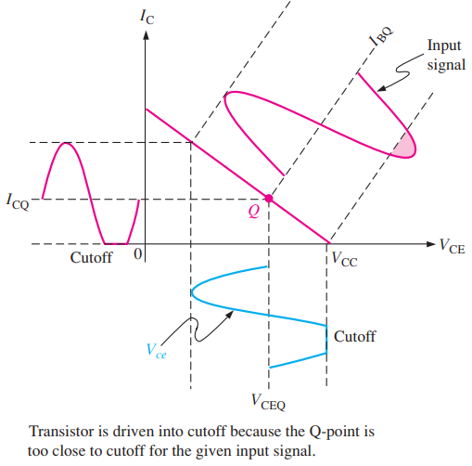
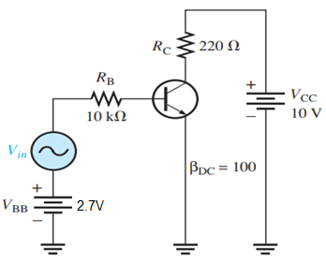
Q-point is shifted toward cutoff region:

Slide 8
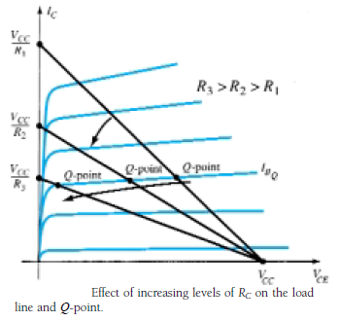
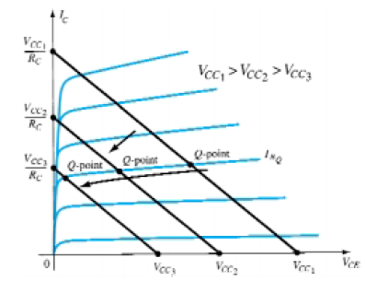
If VCC is held fixed and RC changed, the load line will shift as below
If RC is fixed and VCC varied, the load line shifts as below

Slide 9
The transistor must be biased properly to get undistorted amplified version of input signal
Setting an operating point(Q-point) is the basic criteria of a transistor based amplifier
The Q point is selected in such a way that maximum undistorted signal can be obtained at the output side
Once the Q-point is selected it should not shift the position by changing of I_{C}.
The I_{C} may be changed due to
Variation of β
Temperature variation

Slide 10
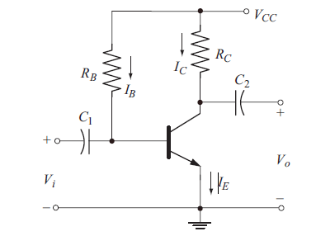
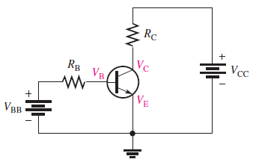
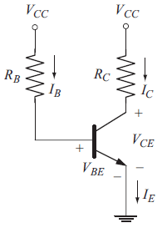
Fixed Bias
A simplest way to bias a transistor is called as fixed bias.
It consists of one source and two external resistors
The dc equivalent circuit can be written by replacing the
capacitors with open circuits

Slide 11
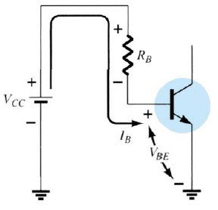

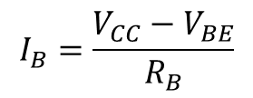
Base-Emitter loop
$$V_{CC}−I_{B}R_{B}−V_{BE}=0$$
$$I_{B}=\frac{V_{CC}−V_{BE}}{R_{B}}$$

Slide 12
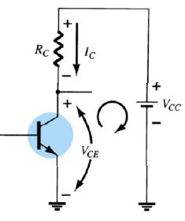



Collector-Emitter loop
$$I_{C}=βI_{B}$$
$$V_{CC}−I_{C}R_{C}−V_{CE}=0$$
$$V_{CE}=V_{CC}−I_{C}R_{C}$$

Slide 13
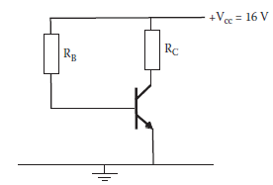
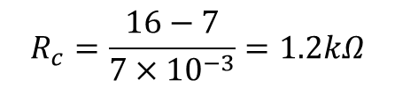

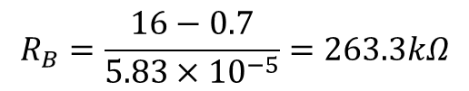
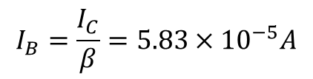


Q1. The operating point for a fixed bias circuit is given by V_{CE} = 7 V and I_{C} = 7 mA. In order to achieve this operating point, determine the value of resistors R_{B} and R_{C}. The transistor has V_{BE} = 0.65 V and β = 120.
$$V_{CC}−I_{B}R_{B}−V_{BE}=0$$
$$I_{C}=βI_{B}$$
$$I_{B}=\frac{I_{C}}{β}=5.83×{10}^{−5}A$$
$$R_{B}=\frac{16−0.7}{5.83×{10}^{−5}}=263.3kΩ$$
$$V_{CE}=V_{CC}−I_{C}R_{C}$$
$$R_{c}=\frac{16−7}{7×{10}^{−3}}=1.2kΩ$$

Slide 14
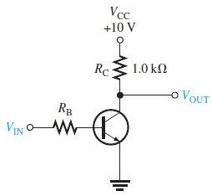
Q2. (a) What is Vce when Vin=0V
(b) What is the minimum value of Ib required to saturate the transistor if beta=200
(c) Calculate the maximum value of Rb when Vin=5V

Slide 15
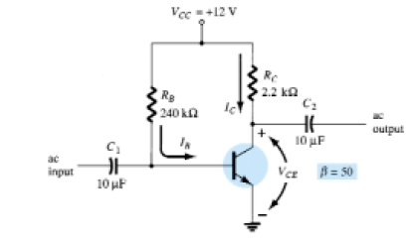



Q3. Determine the following for the fixed-bias configuration of below circuit. Verify the operation region of transistor
(a) I_{BQ} and I_{CQ}.
(b) V_{CEQ}.
(c) V_{B} and V_{C}.
(d) V_{BC}.

Slide 16
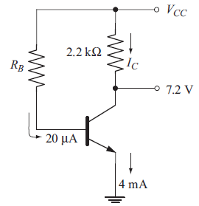
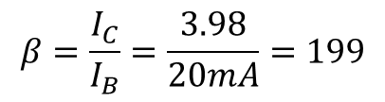
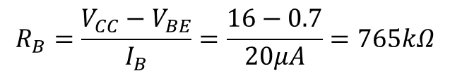

Q4. In the below circuit find I_{C}, V_{CC}, Beta, and R_{B}
I_{B} = 20 microA ; I_{E} = 4 mA ; V_{CE} = 7.2V ; V_{BE} = 0.7V; R_{C} = 2.2 kohm
(a) I_{C} + I_{B} = I_{E}
I_{C} = I_{E} – I_{B} = 4 mA – 0.02 mA = 3.98 mA
(b) V_{CC} = I_{C} R_{C} + V_{CE}
= (3.98 mA × 2.2kohm) + 7.2 V
= 15.956 V
= 16 V
(c)
(d)
$$β=\frac{I_{C}}{I_{B}}=\frac{3.98}{20mA}=199$$
$$V_{CC}−I_{B}R_{B}−V_{BE}=0$$
$$R_{B}=\frac{V_{CC}−V_{BE}}{I_{B}}=\frac{16−0.7}{20μA}=765kΩ$$

Slide 17
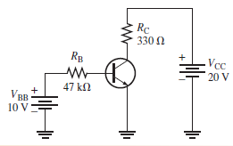
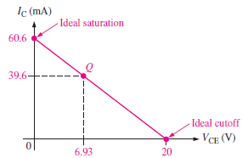
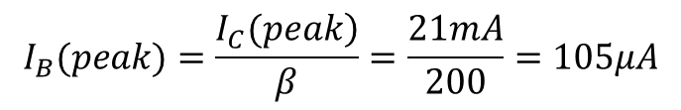
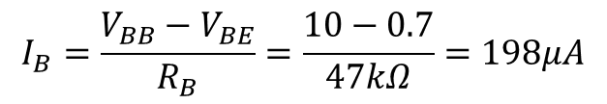
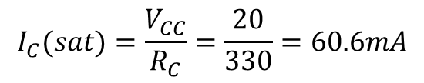
Q5. Determine the Q-point for the below circuit and draw the dc load line. Find the Find the maximum peak value of base current for linear operation. Assume Beta(dc)=200
$$I_{B}=\frac{V_{BB}−V_{BE}}{R_{B}}=\frac{10−0.7}{47kΩ}=198μA$$
$$I_{C}=β_{DC}I_{B}=200×198μA=39.6mA$$
$$V_{CE}=V_{CC}−I_{C}R_{C}=20−13.07=6.93V$$
The Q-point is at 6.93V and 39.6mA
$$I_{C}(sat)=\frac{V_{CC}}{R_{C}}=\frac{20}{330}=60.6mA$$
I_{C} can increase an amount ideally equal to
60.6-39.6=21mA
The maximum peak variation of the base current as
$$I_{B}(peak)=\frac{\left.I_{C}(peak\right)}{β}=\frac{21mA}{200}=105μA$$

Slide 18
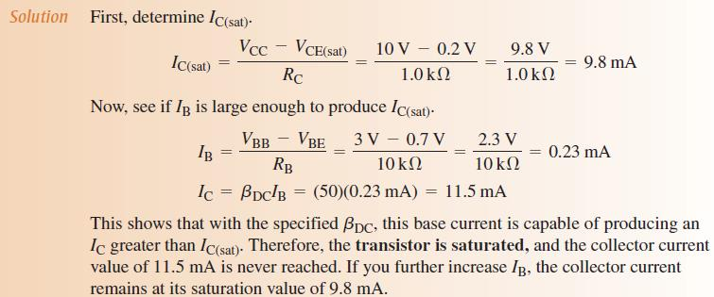
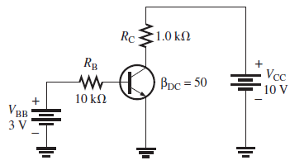
Q6. Determine whether or not the transistor of below figure, is in saturation. Assume VCE(sat) = 0.2 V.

